Slide 1
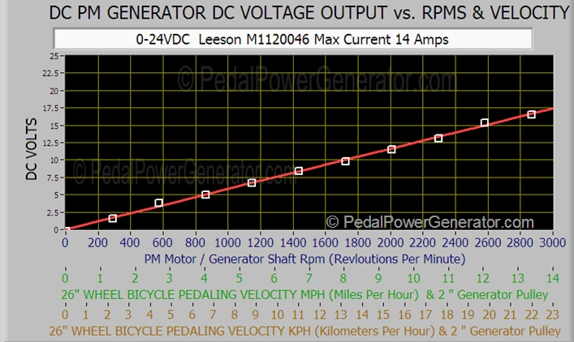
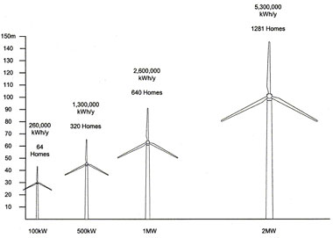
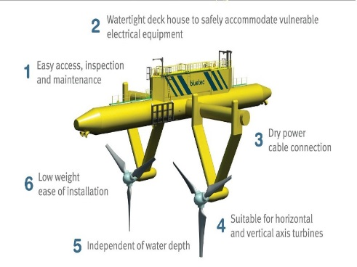
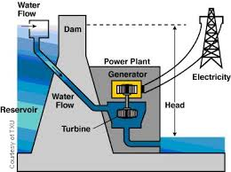
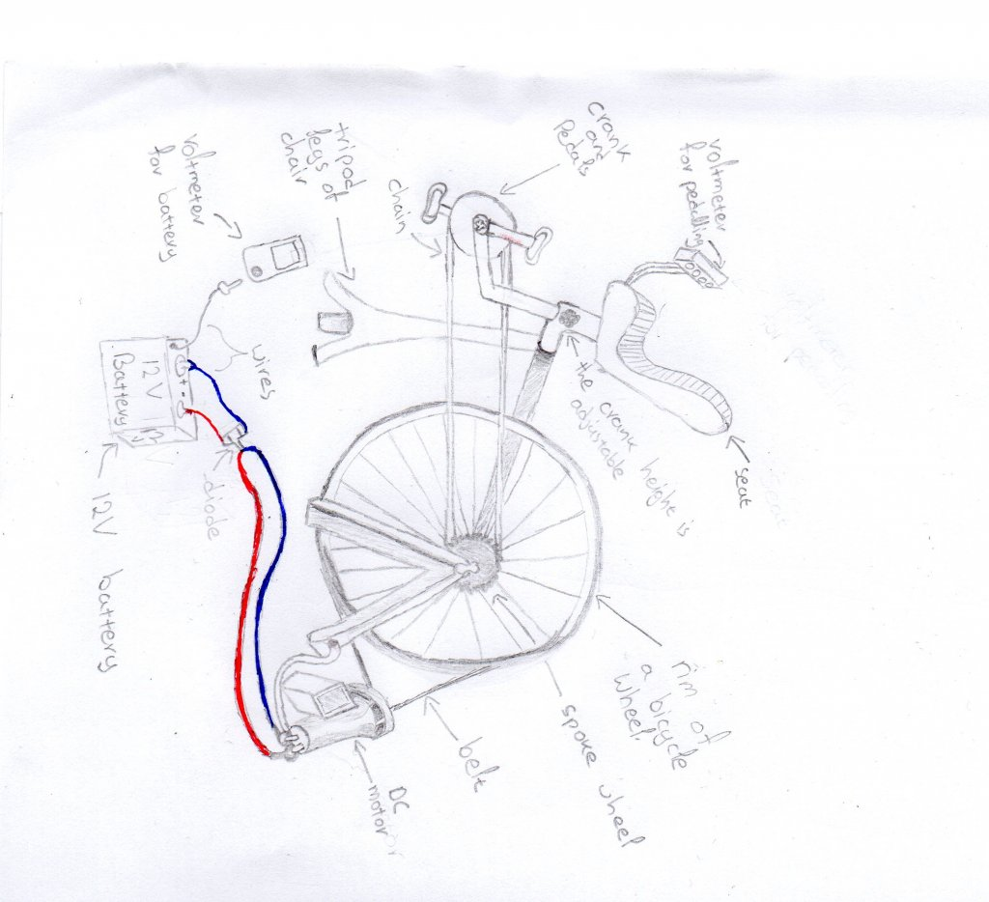
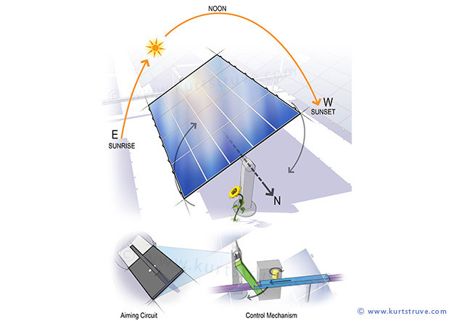
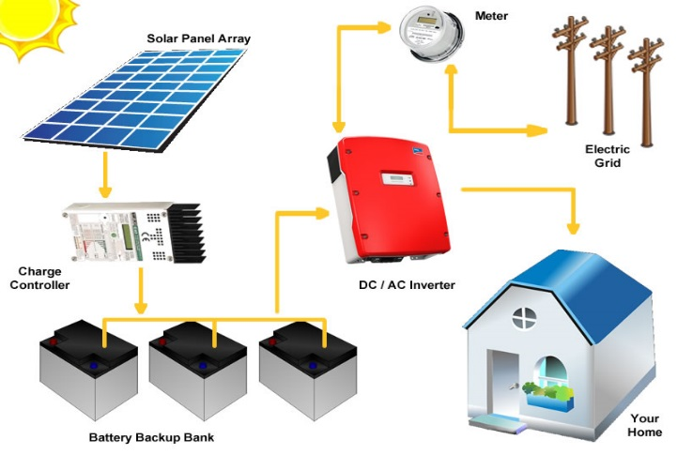
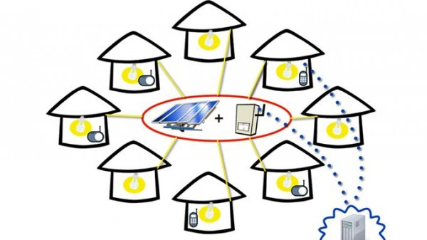
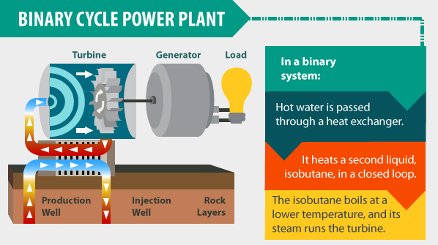
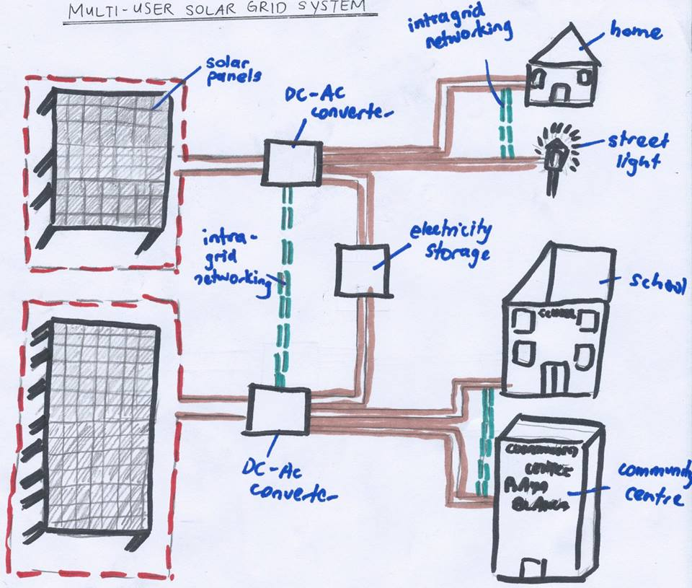
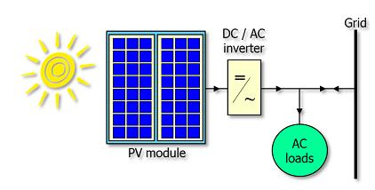
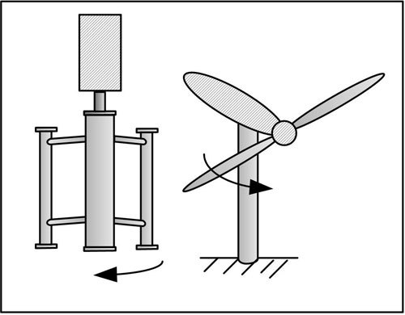
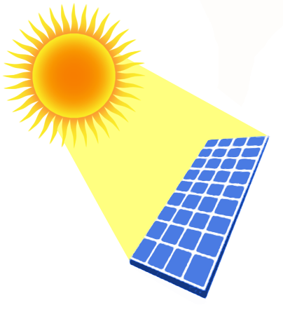
Project Brief:
Design a sustainable and ecological source of electricity, which
is not currently available in Playa Blanca.
Design Evaluation Criteria:
Function: Meet the needs for electricity of the community.
Cost: The income of the locals should be sufficient to pay for the installation and use
of the design and also for its maintenance, which consequently must not be high.
Environment: The solution must provide the community with ecological, sustainable
and renewable energy.
Customer: The users will be the locals.
Materials: The materials must come from Peru.
Energy Research
Pedal Energy
Through the storage of the generated energy in a simple 12V battery, one can use it for light; charge mobile phones even power a laptop and a mixer. 12V Batteries are enough to operate 12V(50W) LED bulbs^{[14]}, which are actually 10 times more efficient than the standard 120V bulb and even shine as bright as a 500W halogen which is more than enough to light a small room sufficiently^{[15]}. They can easily charge 2 average (3.7) mobile phone batteries like the ones used by the community. 12V Batteries can actually solve the problem of lighting and charging mobile phones, but since there aren’t any electricity mains, an easy way to charge those batteries is through pedaling. The voltage generated by the user depends on the rate of pedaling as it can be seen below^{[15]}:
Wind Energy
With a potential of 19GWh per year or 70% of current electricity consumption in Peru, wind energy possess a huge potential to be developed in Playa Blanca. Wind turbines require wind speeds of between 12km/h and 90km/h. The power output of a turbine is given by the equation:-
P= 1/2 *A*p*v^3 ;
where A is the surface area of air being taken in by the turbine, p is the density of air and v is the velocity of the wind. So from the equation we can tell that a turbine with a large wind span will give a greater energy output, if the air is cold as cold air has a higher density than warm air and greater wind speed. As wind speed (v) is raised to the power of 3, we see that it has a greater impact on the power output. Other factors that contribute are The higher the elevation of land the high the wind speed as the air pressure is lower, mountainous regions are therefore a good spot for wind turbines. Very flat land is also a good spot for wind turbines
Playa Blanca is a fairly flat land this makes it suitable for wind turbines, with average wind speed of 17km/h.
Sustainable Energy for Playa Blanca Community in Peru
George Kokkinos, yr 1 Mechanical Engineering
Solar Energy
Peru has a solar energy potential of 3,576,841,559 MWh/year or 5kWh/m² per day ^{[7]}. The annual average day-length in the Piura Region, in which Playa Blanca is located at, is 12 hours – meaning that all year round, Playa Blanca will receive an average of 12 hours of sunlight every day.
One of the advantages of using solar energy is that once the solar panel is installed, the energy is free of charge^{[9]} .In the long run, tariffs that are set will be able to recover the initial investment; especially in a small area such as Playa Blanca. As the energy obtained is free, it will be possible to set reasonable electricity tariffs that will be within the means of the low-income households of Playa Blanca.This form of energy does not cause any pollution nor does it generate noise, and this is essential for the conservation of culture and way of life of the citizens of Playa Blanca. The technology has a very low carbon-footprint due to manufacture and transport;^{[10]} however the process of generating electricity using solar photovoltaics itself do not produce greenhouse gases directly – hence, this technology will have minimal effects on the environment of Playa Blanca or Peru^{[11]}.
Playa Blanca provides a platform for the installation of solar power plant with annual solar radiation more than 2400kWh/m².The current solar cell provides 30% effective rate of solar to electric energy conversion on average. Photovoltaic cell is the most common solar panel due to its low production cost relative to other technologies. The new method, concentrated photovoltaic cell has further bring down the cost to utilise solar power. Average installed pricing for high-concentration PV (HCPV) systems are estimated to have decreased to $2.62 per watt in 2013 and is expected to drop to $1.59 by the end of 2017.^{[13]}
Country Profile
Peru is a country located in northwest of South America. With a land area of 1.27 million km², landscape of Peru spans from basin, mountain to coastal on the west.^{[1]}
Climate also varies from place to place as a result of its geographical location and landscape. Specifically it ranges from tropical in the east, to desert like in the west, and temperate to frigid in the Andes. Both the wettest place and the driest place can be found in Peru.^{[2]}
Peru is classified as upper income country by World Bank with GDP per capita higher than $ 12,000.00.However, the income distribution varies as there is a population of 8 millions live in rural areas with more than 4 million of them under poverty.^{[3]} Peru is a Least Economically Developed Country, a definition based on the industrial growth of the country, but another description that would suit Peru, is that of being a country of contrast. Contrast in some aspects, such as the poverty rates that are 30% in urban areas, where 77.3% Peruvians live, but climb to 55% in rural areas.
Underfunded energy sector in Peru causes the country to face looming energy problems. Electrical line projects, in Choquequirao and another in Chilca, have stalled. As a result, energy-producers are forced to use inefficient diesel plants – hiking up consumer prices. Many isolated communities in the rural areas completely lack access to mains electricity – 37% of rural areas in the country don’t have electricity.^{[3]}
Playa Blanca is a village along the coastline with approximately 250 people living in 49 households.^{[4]}It is a secluded village with very less access to Electricity. Playa Blanca lies in the desert, rural part of Peru, characterised mainly by relatively high temperatures all year round and almost nonexistent precipitation (10-15mm per year).^{[2]} Although they have access to running water, it is not potable, but most importantly they do not have access to electricity, except some houses with diesel powered generators or solar panels, as they are away from the urban areas. Electricity didn’t exist until 2012 when the first diesel generators started appearing. 10% of the houses have their own diesel generators now.
Hydroelectric Energy
Hydroelectricity accounts for 48% of total installed capacity and 72% of electricity generated in Peru. ¹ Energy consumption of a population of 250 does not require a huge power generator. Hence, this renewable source of energy is not recommended as a macro scale generations needed to make it economically viable in addition to the high upfront cost and huge impact to ecosystem as the forest will be compromise for the dam and reservoir.
Tidal Energy
Water is 830 times denser than air, which means tidal energy has higher energy density. This character makes tidal easier to be used than others. But the project finance can be the biggest barrier. This cost around 20 billion pounds and the investment is totally depended on investor's confidence. And maintenance of machines is extremely difficult. The exhibition of tidal energy power may cause the loss of bird habitat. This will also has effect on shipping. This means it is unsuitable for country like Peru, whose main living method is shipping.
[8]
There are 250 people in Playa Blanca residing in 50 households.^{[5]} The families of Playa Blanca use firewood and kerosene to cook food and boil water for drinking. There are on an average 7 people in a typical household in Playa Blanca. Members of the family include children, adults and the elderly.^{[5]} The men of the house are involved in activities like fishing and agriculture. The women are mostly housewives doing all household chores like cooking, suffering from respiratory problems, back aches, eye irritation and breathing problems due to the use of kerosene. The children study at night under candlelight or flashlights. Through an Energy Requirement model the Total Energy required = 13,500 kWh per year.
In order to ensure a continuous supply of energy and keeping in account extra energy in case of a grid failure the energy that needs to be produced by the solar Power Plant = 15,000kWh per year.
5-Pedal Power Batteries
The energy created through pedaling is actually conserved in a 12V battery. The user gets on the seat which rests on a rigid tripod, and starts pedaling. The distance of the crank from the seat is adjustable to suit users of any height. By pedaling the rim also spins, as the crank and the spoke wheel are connected with a chain. The rim is connected in similar way to a motor, by the use of a belt. Another way to connect the two would be a roller, but a belt is much quieter and more efficient than the roller. Consequently the motor starts rotating thus generating electricity. This is transferred by wires to the positive and negative terminals of the battery, charging it until it reaches 12V. The use of the diode before the battery is important to make the energy flow in just one direction, from the motor to the battery not the other way around, or else the battery wouldn’t charge. The voltmeter on the seat indicates how much voltage the user generates through pedaling. But the voltmeter for battery simply indicates when the battery is fully charged. All those materials can be provided from any hardware store, making this design feasible.^{[16]}
3-Multi-user Solar grid system
Multiple solar panels will capture sunlight, and via photochemical reaction, which converts solar energy into electrical energy. This energy will be transferred via cables to a DC-AC converter to convert the DC current into AC current and vice-versa. There are intra-grid networking cables placed between the converters; so that in event of failure of one converter, electricity can be transferred from an adjacent converter. In this simple model, there are 2 major solar panel stations. To increase efficiency, the northern solar panels will supply less electricity as opposed to the southern solar panels, as electricity from these panels will power some homes and the street lighting. The southern solar panels will provide more electricity as it will power the school, community center and nearby homes. Both solar panel stations will provide electricity to the electricity storage, which is in the form of a battery. This storage is for consumption during night time or on cloudy, rainy days. There are intra-grid networking cables placed between adjacent grids - again, this is an emergency backup, for if one cable fails, another cable will supply electricity to that cable. ^{[19]}
_{[6]}
7-Binary Cycle Geothermal Power plant
The binary cycle power plant uses the energy of moderate temperature water (107 Cº-182 Cº) in the ground. It uses the coldest reservoirs, which is an important advantage as it makes the plant available in more areas. Water from earth’s reservoirs passes through a pipe to a heat exchanger, adjacent to another pipe that contains an organic compound liquid, which is in simple terms a type of water with low boiling point. Heat is exchanged between the hot water and the liquid, which turns into steam that runs the turbine, which consequently produces electricity. It is not feasible for the plant to be built with materials from Playa Blanca, but instead they will be imported from the states. The problem like in almost every project is the funding. It’s an expensive project and may cost several hundreds of thousands; the real struggle is to find investors who are willing to risk their money in building something complex for a rural community of 250 people ^{[18]}
Design Concepts
1-Flexible Solar panels
A Solar Plant 900-1000m^2 big can generate enough electricity for the village.
The Solar Plant can be installed near the village where solar arrays will absorb energy from the sun for an average 5-6 hours a day. The Solar Panels will be flexible to change orientation according to the sun. The Direct Current Electricity generated will be sent to a series of Grid Tie Inverters that will convert the DC Electricity into AC Electricity. Once this is done some part of the electricity will be stored in a facility for future use in case of a grid failure. There will be a continuous supply of electricity to all the houses via means of over-head grid lines. The only reason to use over-head grid lines is to minimize the investment cost of the project. ^{[17] [18]}
2-Pay as you go Solar Power
There will be 3 solar panels per house as one can only produce 200W of energy. So:
3panels*200W*6hours of sunshine*365days = 1,314kWh/yr
150 panels for 50 households will be needed with the average installation cost ranging from $800 to $1400
The whole system will be easy to use as solar panels will be installed on the roofs of people's houses and a with a few wires will be connected to the whole house. Electricity will be bought from a convenient store in the form of a code which householders will simply need to punch into their meter. Pre-paid meters will be installed in each house which are easy to use and only require a few easy instructions.
6-On grid and Off grid solar cells
An off grid system is supposed to be self sufficient, however it needs a carefully designed storage facility. A grid connected system however connects to the local grid and transfers electricity by exchanging with the national grid.
Therefore, the grid can be placed few kilometers from Playa Blanca and can still provide electricity to the village safely^{.[19][20]}
4-Tidal Powered Generator
It makes use of the kinetic energy of moving water to power turbines, in a similar way to wind turbines that use wind to power turbines. Land constrictions such as straits or inlets can create high velocities at specific sites, which can be captured with the use of turbines. These turbines can be horizontal, vertical, open, or ducted and are typically placed near the bottom of the water column.
Critical Analysis and Technical Argument
After careful study of all the proposed solutions to the problem in Playa Blanca, it was concluded that the most suitable for this is to use solar energy, in the way proposed by design solution 3#. It is a renewable, sustainable and an Eco-friendly solution to Playa Blanca's electrification issues. It meets most of the design criteria set, and it meets the brief fully.
Out of all the proposed solutions, it mostly meets the first design criterion which is' Function'. Solar energy for Playa Blanca is feasible because it has the ideal climatic conditions because it lies in the equatorial region. This means it receives sunshine throughout the year as compared to other places. Solar energy reaches average levels of approximately 5kWh/m2/day ^{[29]}.
The cost will be similar to that of the 2nd idea, which is relatively high compared to wind turbines and the pedal powered batteries, but through investment, the costs can be covered.
It also meets the 3rd criteria to some extent, suggesting that the landscapes will not suffer from visual pollution. It may not be as to move different departments of the station, like the pedal powered batteries which can be stored in a closet, in order not to pollute the environment, but the stations and different departments are relatively small compared to the size of the landscape.
The target users are the locals in this case like in every design. Following the allocated path by every single one of the 7 solutions, the target users are the locals, and the origin of the materials are unknown but certainly those materials for such a project will not be found around Playa Blanca but most probably will need to be imported form the center of Peru, unlike the pedal power batteries, whose materials can be found in an average household and the average convenience store.
It is a desirable project as it will bring economic development to the Playa Blanca people as it will provide jobs and their village as it will attract investors. Additionally, the locals are already familiar with solar power so this will not be a new thing to them and so they will be more accepting. Moreover, the system that has been designed which involves the installation of meters in homes is one that is easy to operate. It is also desirable as it will meet the electricity needs of the population which
It is economically viable because a similar project was done in a small village in Africa with 600 people ^{[30]}.
Playa Blanca being relatively rich in mineral resources^{[1]} it is certain that it will receive a large amount of investors which will potentially become shareholders of the energy project or just consumers of it. This will be a very good source of capital to fund the project.
Grid Tie Invertor:
Makes DC in phase
70% ELECTRICITY
DC in phase
Storage
1) Use at night
2)In emergencies
DC in phase
Grid Tie Invertor:
Converts DC to AC
Intragrid Networking
FINAL SOLUTION
AC to the community
-At night
-In Emergency
X 100
30% ELECTRICITY
Grid Tie Invertor:
Converts DC to AC
Intragrid Networking
# | DESCRIPTION | COST PER UNIT/ U$D | NUMBER OF UNITS | TOTAL COST/ U$D
1. | Solar Panels ^{[25]} SW 270 Silver Mono Protect (1.67m x 1.01m; Area 900m² ) | 418.00 | 534 | 223,212.00 (~250,000.00)
2. | Batteries ^{[26]} Exide OPzS Solar 3850Ah | 4,402.69 | 2 | 8805.38 (~ 10,000.00)
3. | Inverters ^{[27]} SatCon PowerGate Plus PVS-30, 30kW 208 VAC, Grid-Tie Inverter/Transformer | 25,318.20 | 3 | 75,954.60 (~ 80,000.00)
4. | Cables ^{[28]} MC4 10 AWG 100’ Cable Extension (3.75km in total) | 80.00 | 125 | 10,000.00
5. | Salaries and Consultation Charges |  |  | 300,000*
6. | Delivery Costs and Transportation Charges to Playa Blanca Region |  |  | 100,000*
7. | Miscellaneous Costs (Emergencies etc.) |  |  | 200,000**
 | GRAND TOTAL : |  |  | 950,000.00
AC to the community during the day
Final Energy Solution
The final solution will utilize Playa Blanca’s geographical and climatic advantage of receiving an abundance of sunlight all year round, to convert solar energy into electrical energy via photochemical reaction. To combat the renewable energy problem in Playa Blanca and having explored a vast variety of sustainable energies hybrid multiuser solar grid (MSG) was decided.
The MSG system is divided into three parts. The first part is the solar panel area, where 100 photovoltaic cells of size 2m­² will produce 15000kWh/year of electricity. The panels are oriented at 15°to ensure that maximum sunlight is absorbed at all times. This section will be built on a flat terrain land 2km to the west of the village, to ensure that it is at a safe distance away from inhabitants.
The second part of the MSG is the streams area. Electricity is transmitted via insulated copper wire cables from the panel area, and are then split into two streams. The first stream is the demand stream, where 30% of electricity is transmitted directly to the village; whereas the remaining 70% is transmitted to the storage stream. It is set that 30% of the electricity will be used during day time, which is an overestimate, so that electricity demand during that time period does not exceed supply. The storage stream provides electricity at night and for emergency. Two 48V lead acid batteries with a capacity of 370kWh will be used to store electricity. To convert generated direct current into alternating current for village electricity consumption, modified grid-tie inverters (GTI) are connected to the streams. These GTIs also store excess energy that is not consumed after generation. A special GTI is connected before the storage unit, to ensure that all DC electricity transmitted are in phase before being stored. There are several intra-grid networking between streams. This is to ensure that if one stream fails to function, the other stream will temporarily power the other stream until it is repaired.
The third part of the MSG is the consumption zone. Electricity is transmitted via overhead copper cables to the village zone. Electricity is distributed via the means of a pay-as-you-go tariff card and pre-installed smart meters at homes or designated areas.
References
[1]Information provide on Moodle by department and WindAid.org [2] https://www.cia.gov/library/publications/the-world-factbook/geos/pe.html [3] http://data.worldbank.org/country/peru [4] http://travel.nationalgeographic.com/travel/countries/peru-facts/ [5] https://moodle.ucl.ac.uk/mod/page/view.php?id=1668587
[6] http://www.inside-peru.com/image-files/bandera_flag_peru.jpg
[7] CIA World Fact book :http://en.openei.org/wiki/Peru
[8] http://www.piura.climatemps.com/graph.php
[9] http://www.ruralelec.org/fileadmin/DATA/Documents/06_Publications/Position_papers/ARE_Publication_-_Case_studies_for_renewables_in_Developing_countries.pdf
[10]http://www.edfenergy.com/energyfuture/energy-gap-climate-change/solar-and-the-energy-gap-climate-change
[11] Process Induatry Forum:http://www.processindustryforum.com/hottopics/advantages-and-disadvantages-of-solar-energy
[12] Caracas (2014.Oct.25) http://www.laht.com/article.asp?ArticleId=848797&CategoryId=14095
[13] http://www.ruralelec.org/fileadmin/DATA/Documents/06_Publications/Position_papers/ARE_Mini-grids_-_Full_version.pdf
[14] http://scienceshareware.com/bicycle-generator-faq.htm#volts
[15]Joe Greene:http://ledthisway.com/why-low-voltage/
[16] http://www.instructables.com/id/Pedal-Powered-Battery-Charger/?ALLSTEPS
[17]http://www.kurtstruve.com/images/technical/6_sun_tracking_pv
[18]http://primusservices.co.in/image/data/products/typical-layout-grid-tie-pv-with-battery-backup.jpg
[19]http://www.climateparl.net/cpcontent/pdfs/MBriganti_MINI_GRID%20SYSTEMS.pdf
[20]http://ec.europa.eu/energy/publications/doc/2009_report-solar-energy.pdf
[21]http://www.ewi.tudelft.nl/en/the-faculty/departments/electrical-sustainable-energy/photovoltaic-materials-and-devices/dutch-pv-portal/pv-how-does-it-work/?amp%253BL=0
[25] http://www.wholesalesolar.com/products.folder/cable-folder/mc4-extension-cables.html
[26] http://www.gogreensolar.com/products/satcon-powergate-plus-pvs-30-30kw-208-vac-grid-tie-inverter-transformer
[27] http://www.amazon.co.uk/gp/offer-listing/B007U6KA6G/ref=dp_olp_new_mbc?ie=UTF8&condition=new
[28] http://www.wholesalesolar.com/products.folder/module-folder/SolarWorld/sw-270-protect.html
[29]:http://en.openei.org/wiki/Peru
[30]:http://www.energias-renovables.com/articulo/african-island-goes-green-with-solar-microgrid
The actual project is work of : Arvinran Rajendran, Ratik Maharajan, Shujie Pan, Jin Hao , Sandiipan Ganguli, Salem Morelli, George Kokkinos
Tabulated on the left is the costs associated with the final energy solution for the community of Playa Blanca.

